Slide 1
Morphological Operations on Image (Erosion, Dilation, Opening, Closing and Hit and Miss Transform)

Slide 2
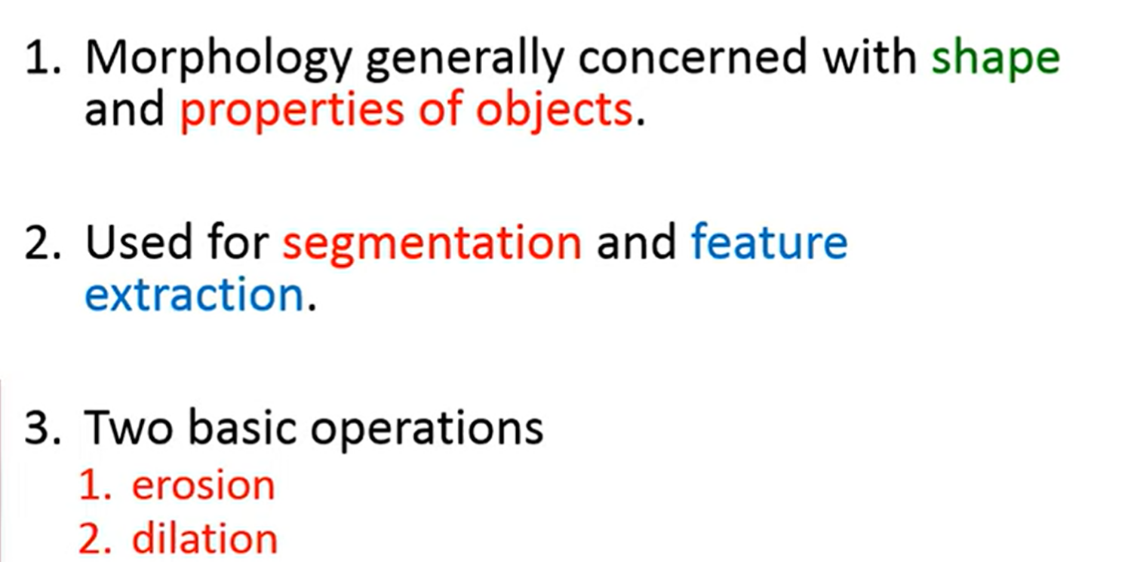
Morphology

Slide 3
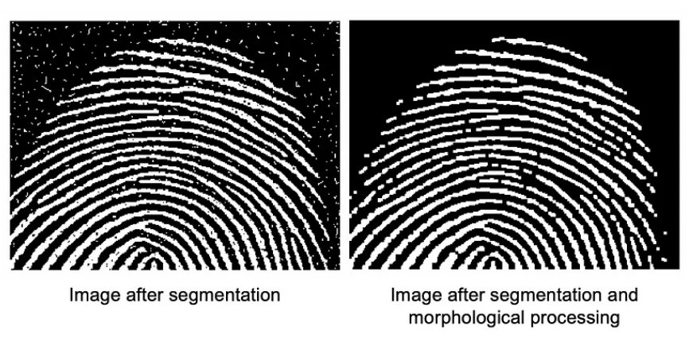

Slide 4
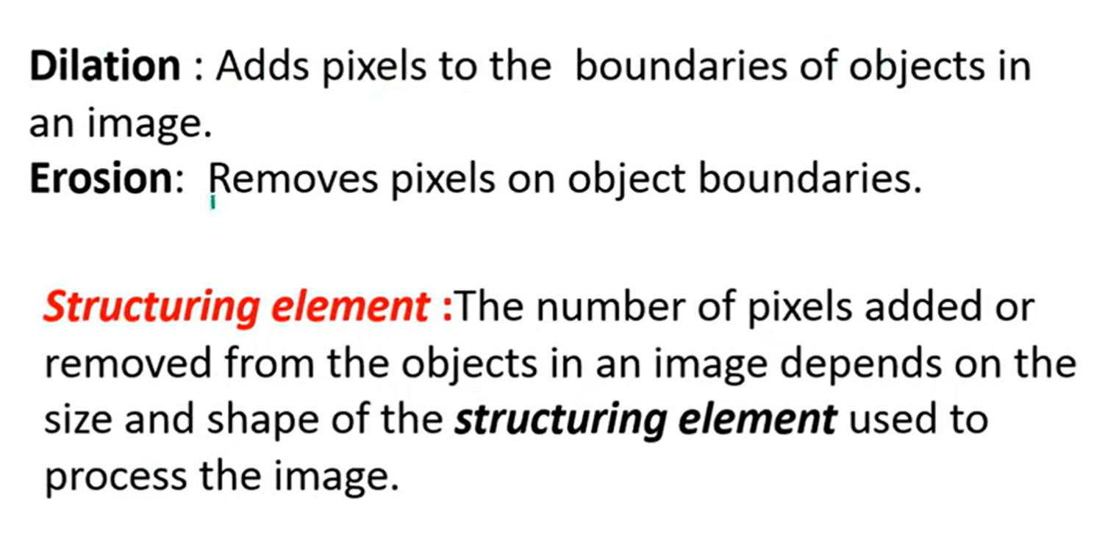
Dilation and Erosion
Notes:
The erosion operation shrinks the boundaries of objects in an image. For example, when you apply the erosion operation to an image, the bright areas get thinner and the dark areas get bigger.
Dilation
The dilation operation gradually enlarges the boundaries of bright regions in an image.

Slide 5
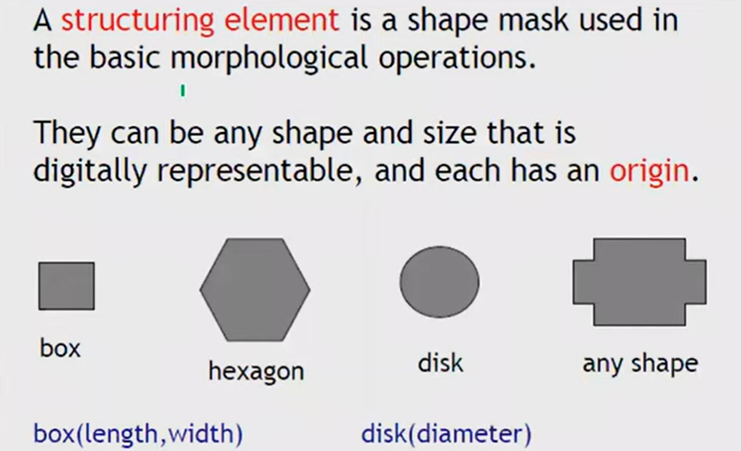
Structuring Element

Slide 6

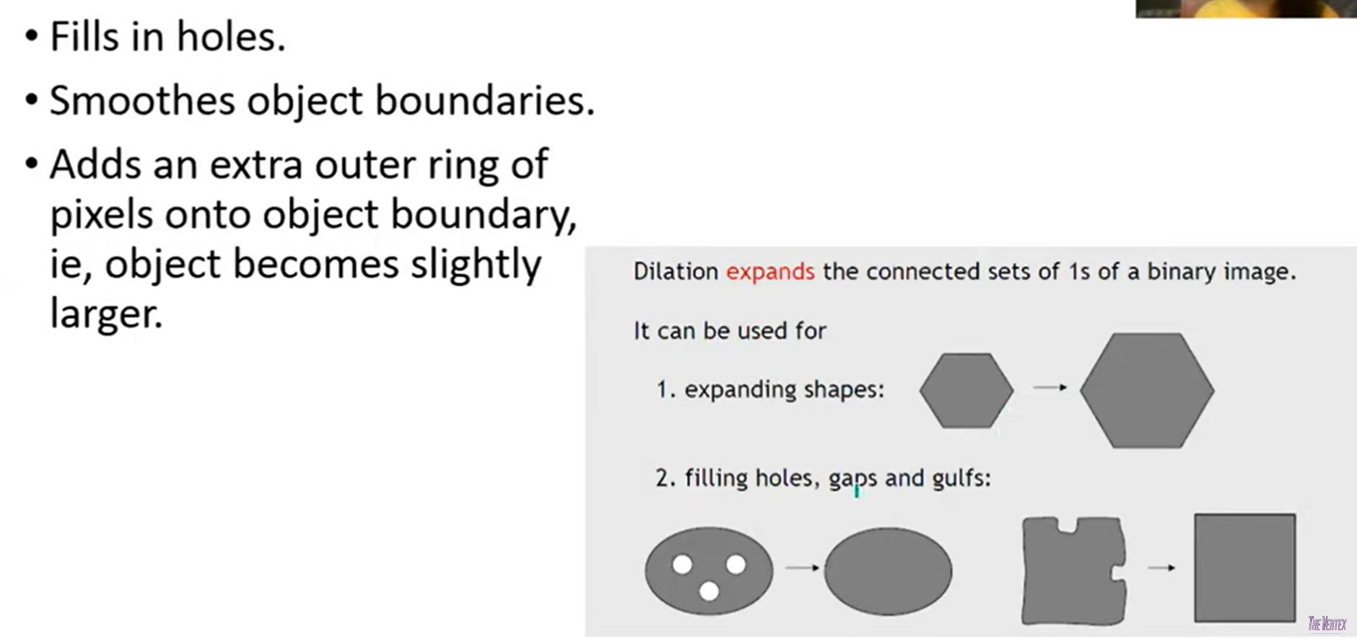
Dilation

Slide 7
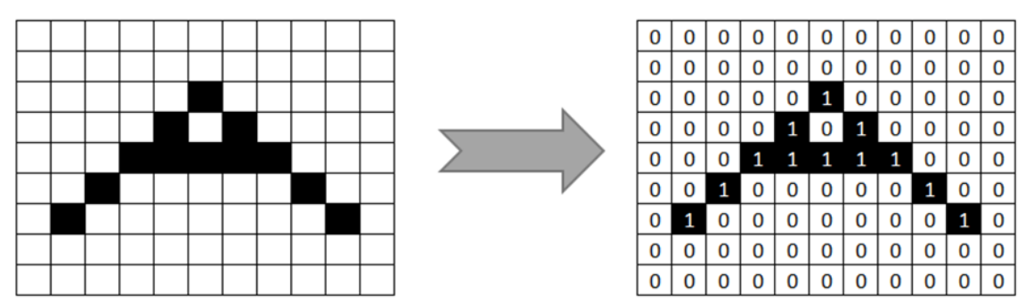

Slide 8
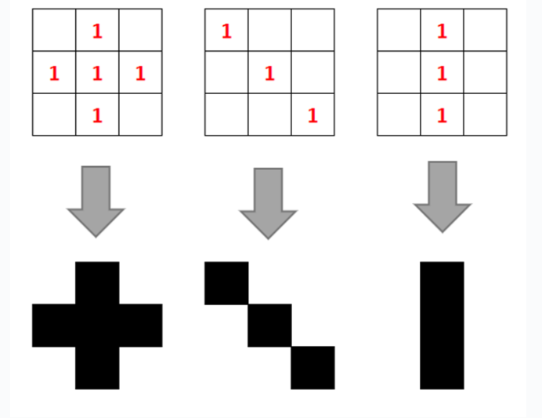
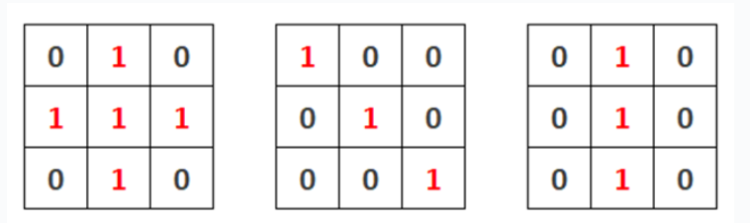
Structural Element

Slide 9
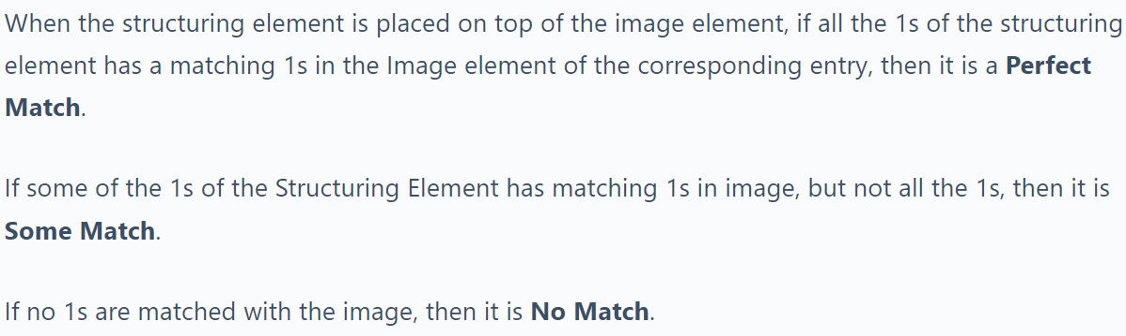

Slide 10
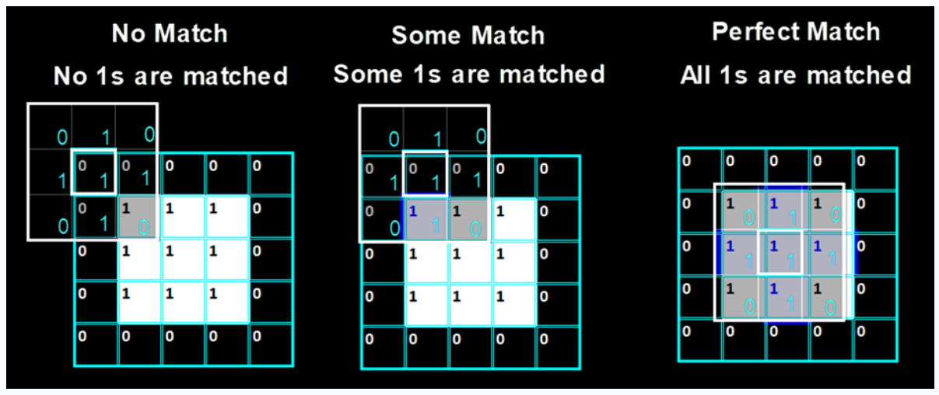

Slide 11
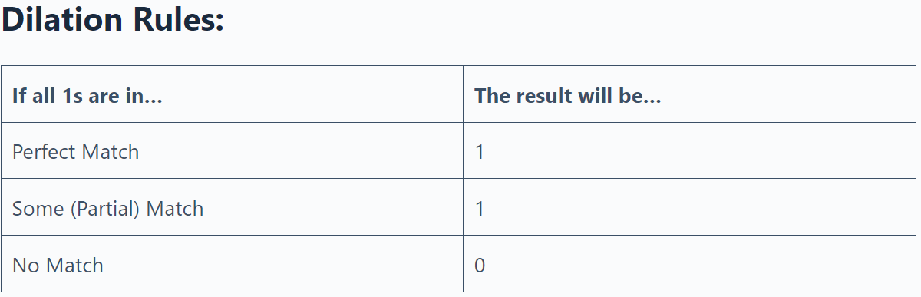

Slide 12
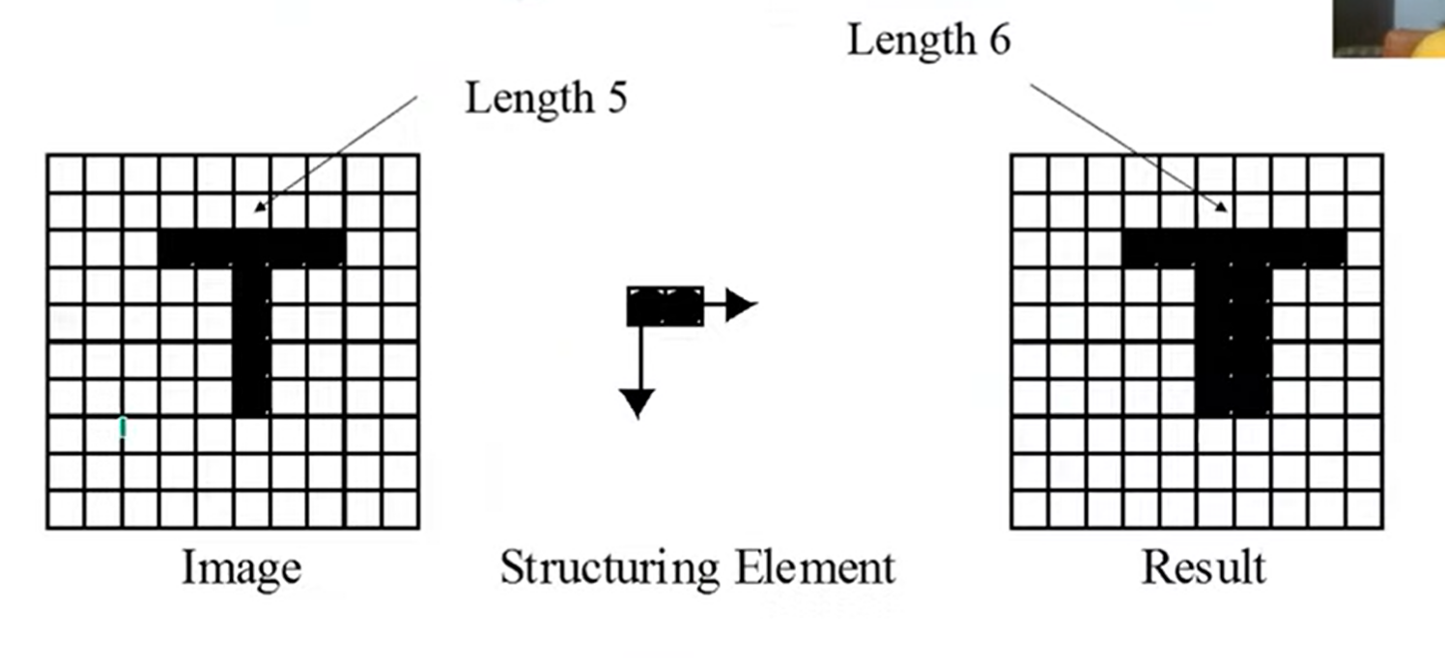

Slide 13
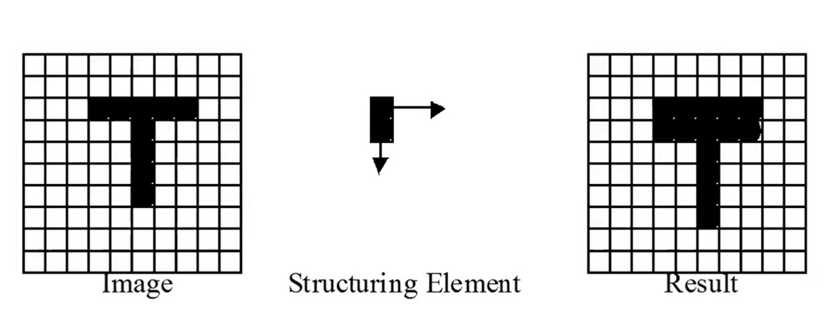

Slide 14
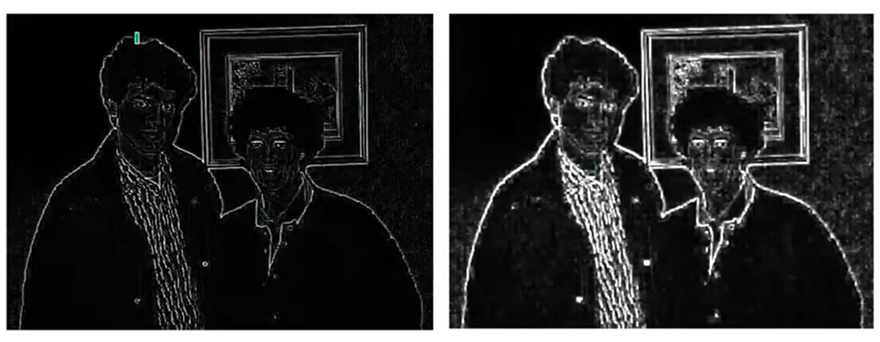
Example

Slide 15
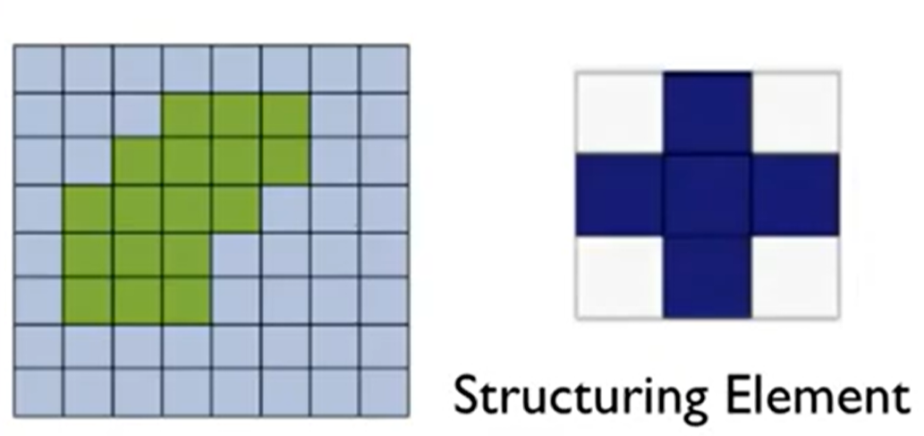

Slide 16
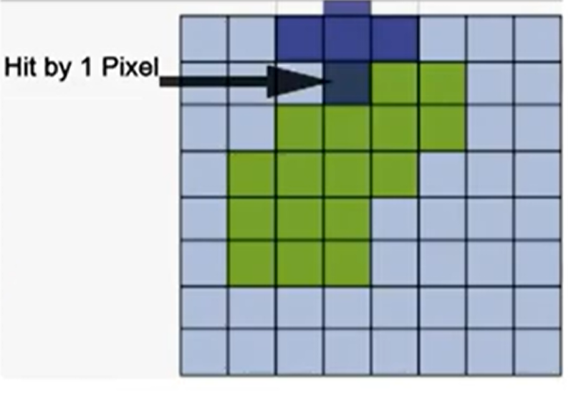

Slide 17
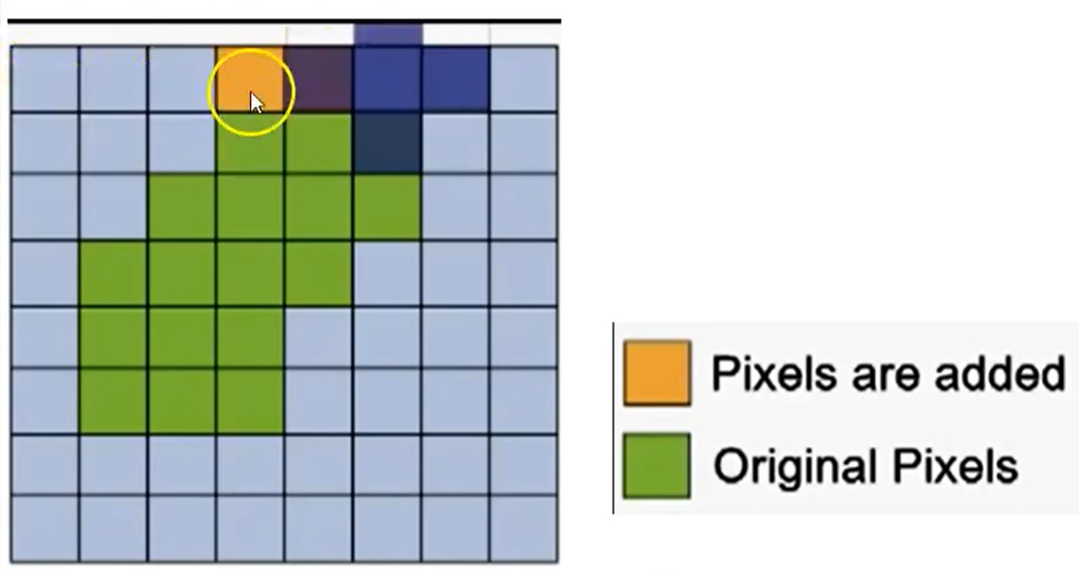

Slide 18
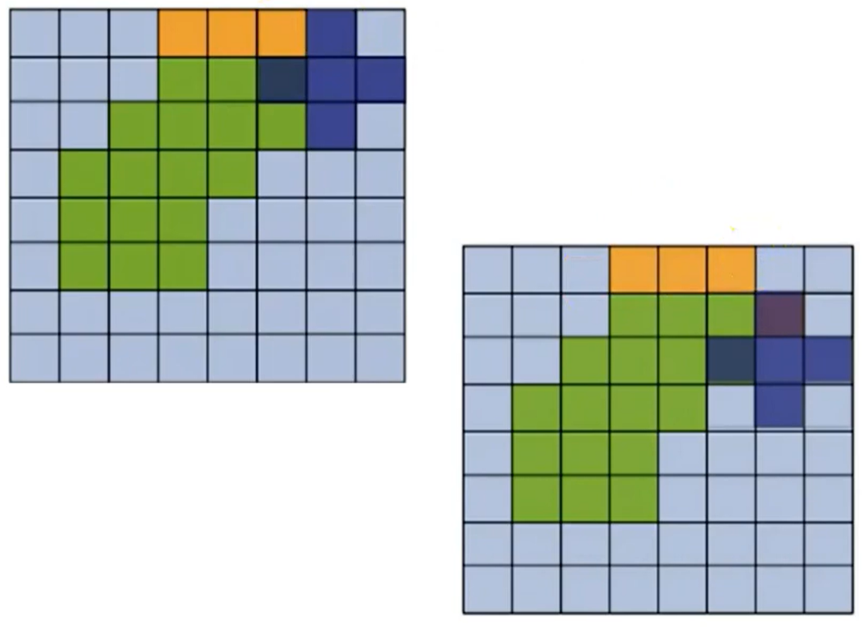

Slide 19
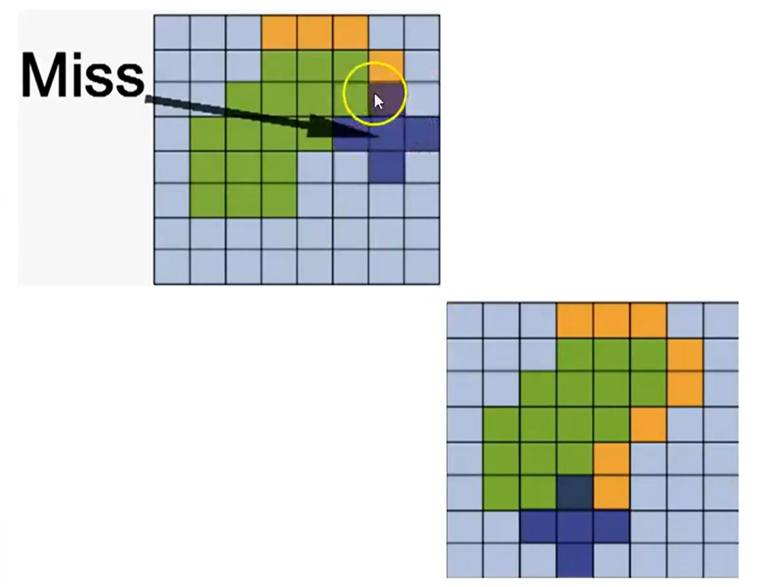

Slide 20
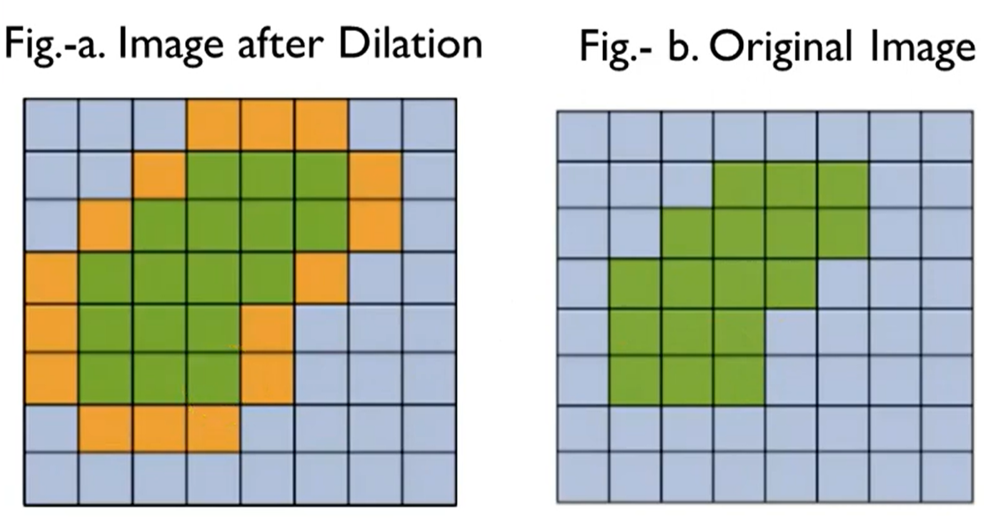

Slide 21
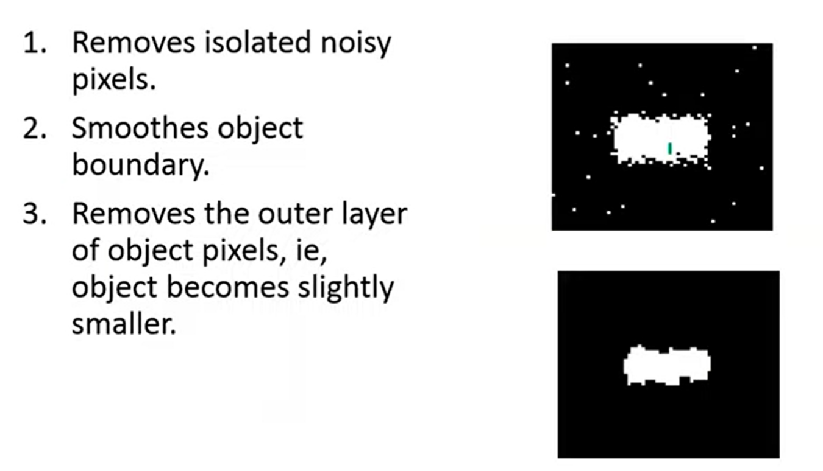
Erosion

Slide 22
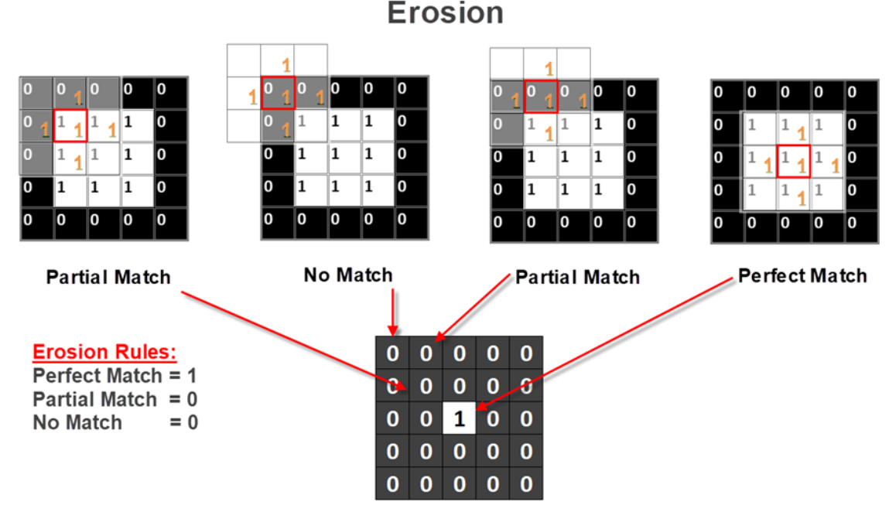

Slide 23
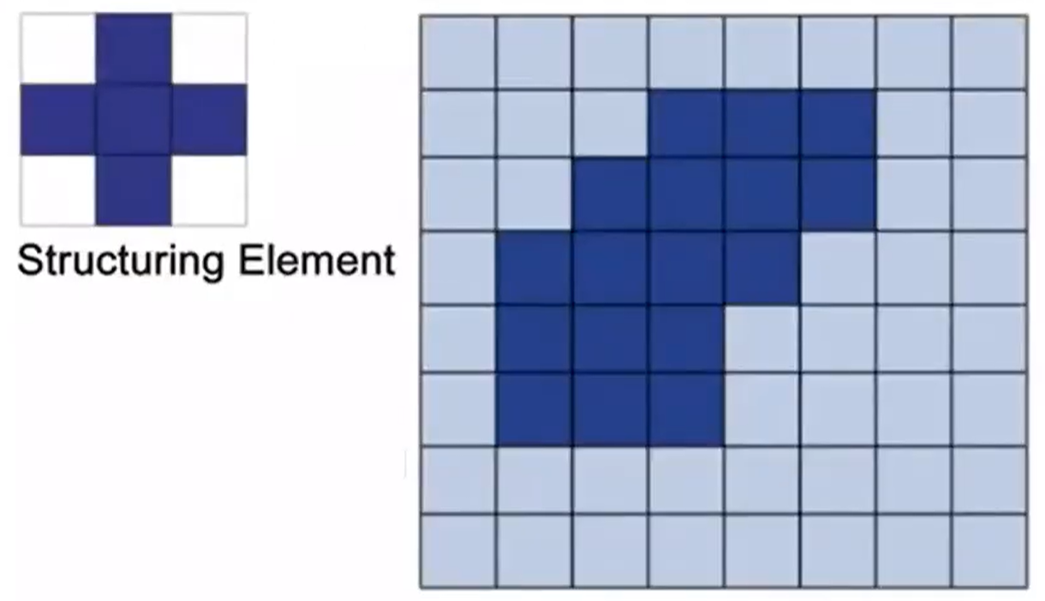

Slide 24

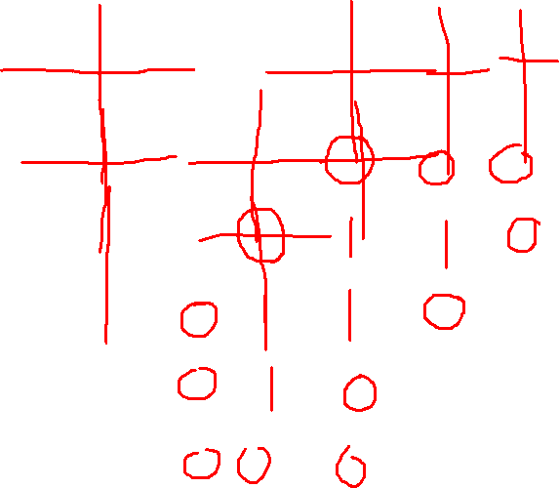

Slide 25
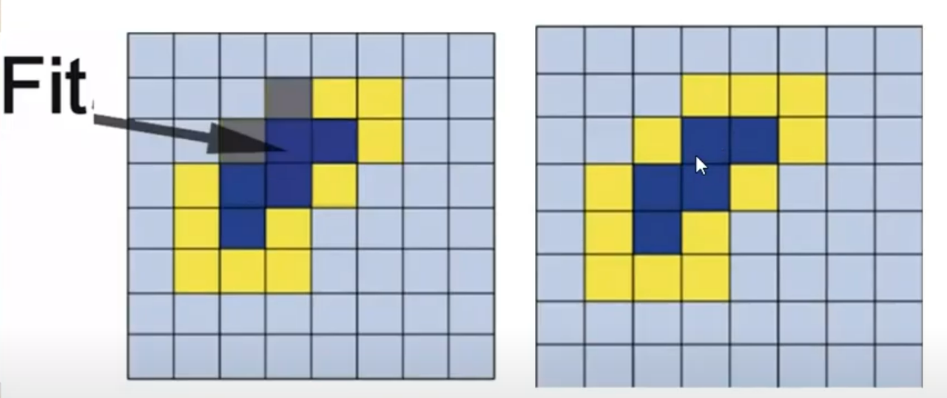

Slide 26
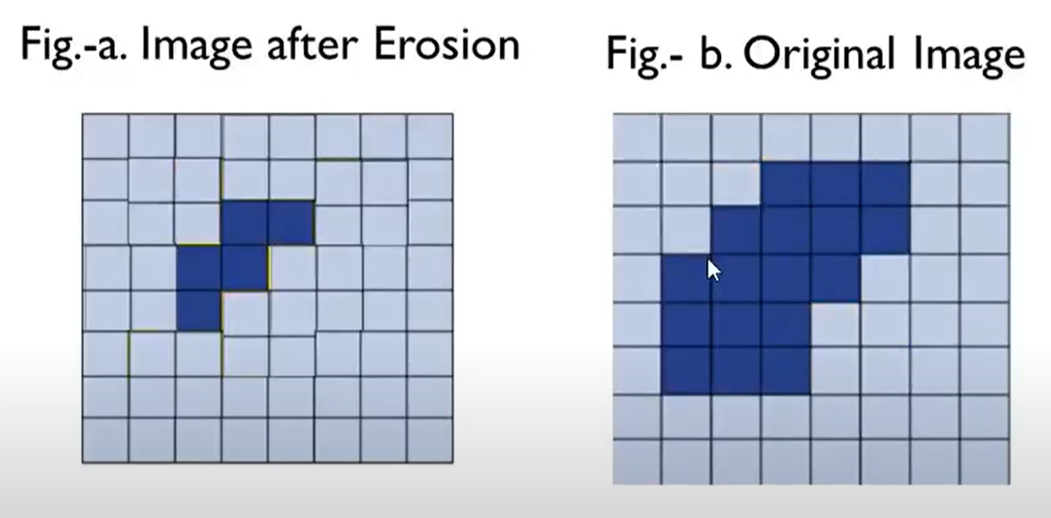

Slide 27
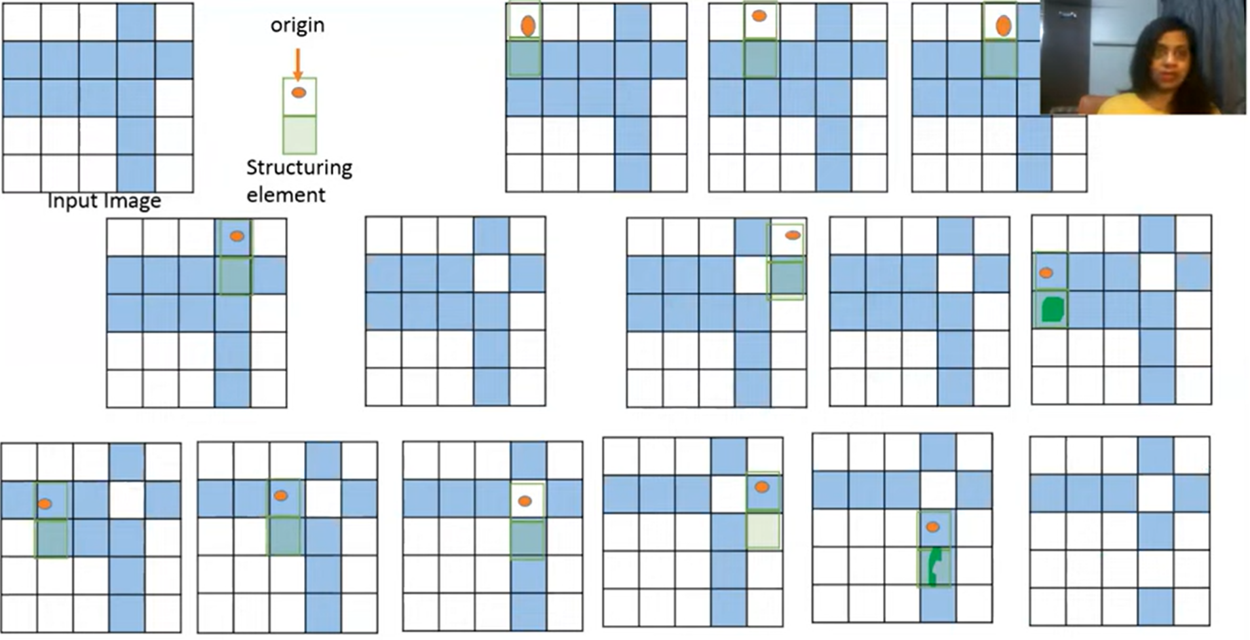

Slide 28
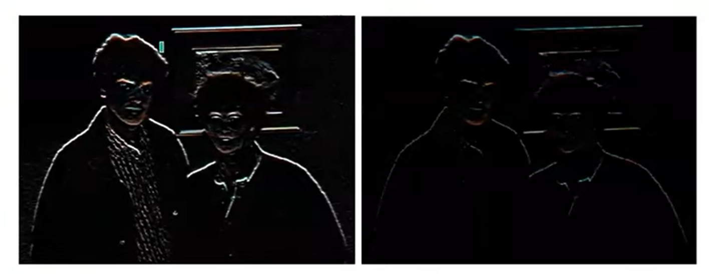
Example

Slide 29
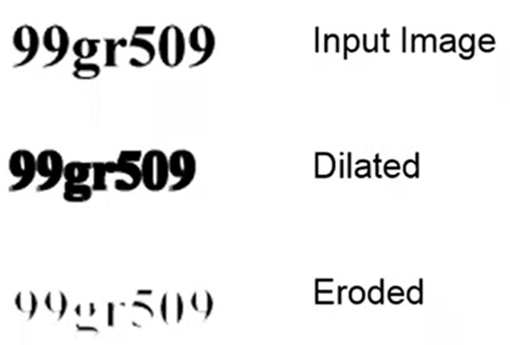

Slide 30
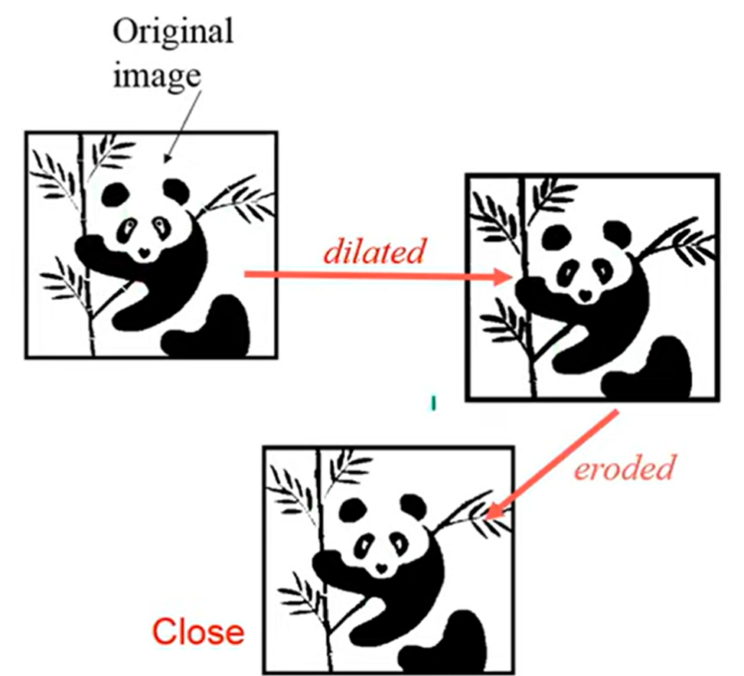

Slide 31
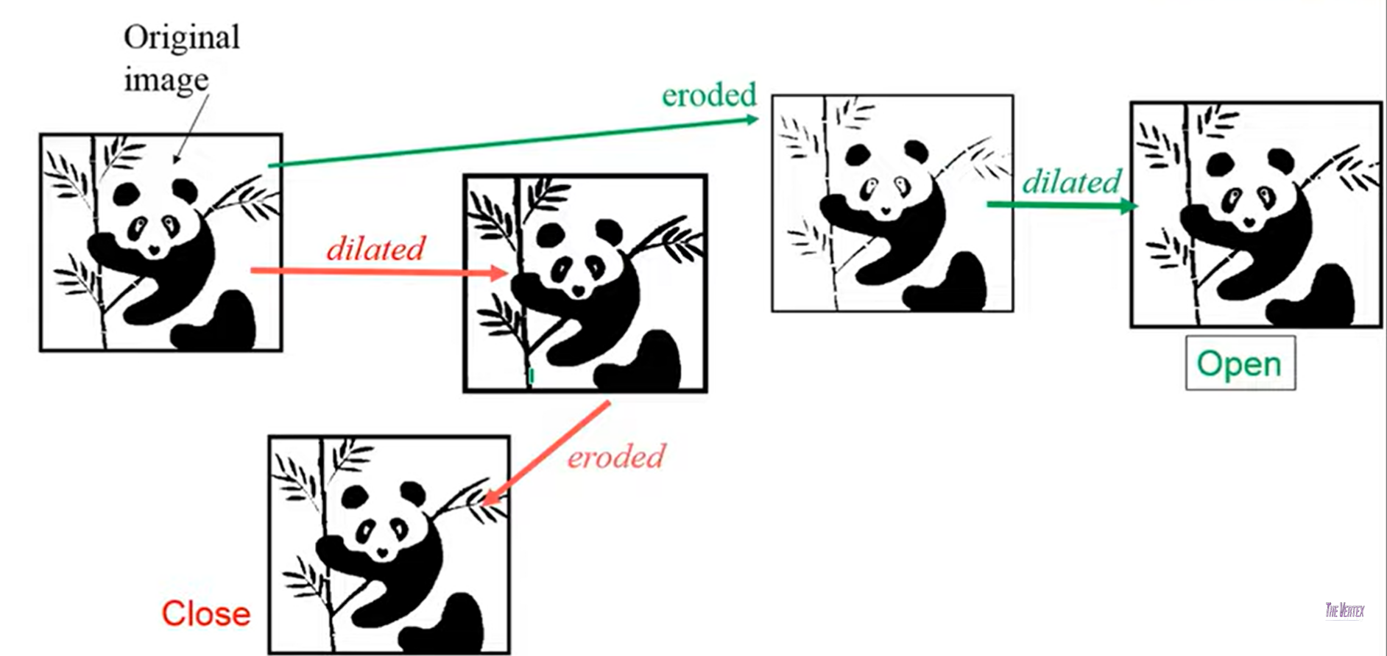

Slide 32
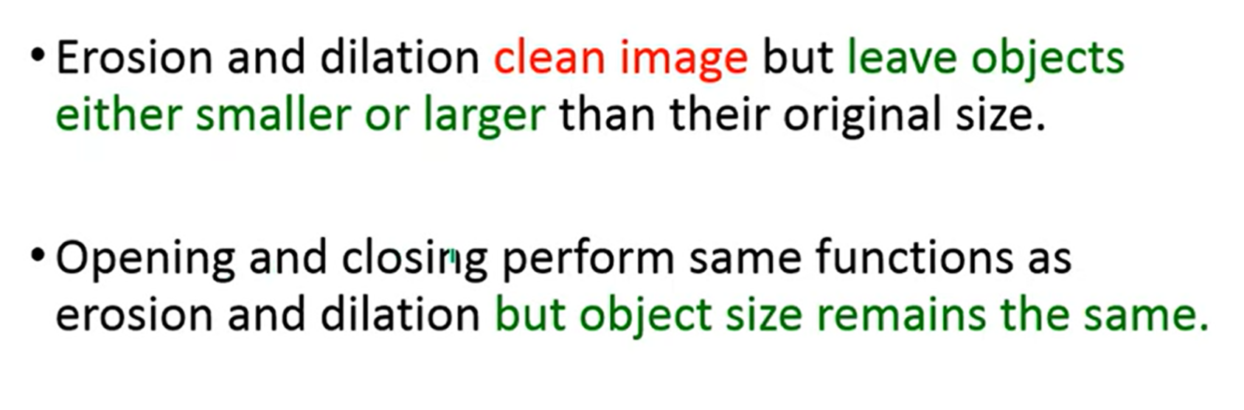

Slide 33
Steps to be followed
Create a function to handle the erosion operation. The function should take two inputs:
image: The grayscale image (as a 2D array).
se: The structuring element
Get the Image and Structuring Element Dimensions
Calculate the center of the structuring element, which will be used to apply it symmetrically around each pixel
Create an Output Image: np.full_like(image, 255)
Loop Over the Image Pixels

Slide 34
Initialize Local Minimum Value: For each pixel, start by setting a local minimum value. This will be used to track the minimum intensity value in the neighborhood defined by the structuring element.
Apply the Structuring Element: For each element in the structuring element that is 1, compare the corresponding pixel in the image and update local_min if the pixel value is lower than the current local_min
Assign the Local Minimum Value: Once the structuring element has been applied to the pixel and its neighborhood, assign the calculated minimum value to the current pixel in the eroded image.
Return the Eroded Image
Formula:
Dilation: C(x,y) = Maximum{A(x-i, y-j) X B(i,j)}
Erosion: C(x,y) = Minimum{A(x-i, y-j) X B(i,j)}

Slide 35
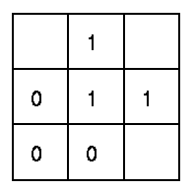
Hit and Miss Transform
The hit-and-miss transform is a general binary morphological operation that can be used to look for particular patterns of foreground and background pixels in an image.
foreground pixels are denoted using ones, and background pixels using zeros

Slide 36
The hit-and-miss operation is performed by translating the origin of the structuring element to all points in the image,
then comparing the structuring element with the underlying image pixels.
If the foreground and background pixels in the structuring element exactly match (Hit) foreground and background pixels in the image, then the pixel underneath the origin of the structuring element is set to the foreground color (1). If it doesn't match (Miss), then that pixel is set to the background color (0).
B = (B1, B2) composite structuring element
B1: elements of B associated with the object
B2: elements of B associated with the corresponding background
A B = {a|B1 ∈ A and B2 ∈ A^{C} }

Slide 37
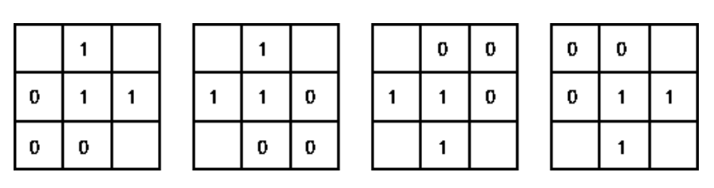
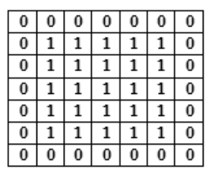
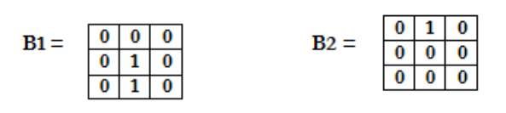
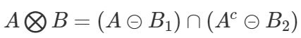
B1
B2
B3
B4

Slide 38
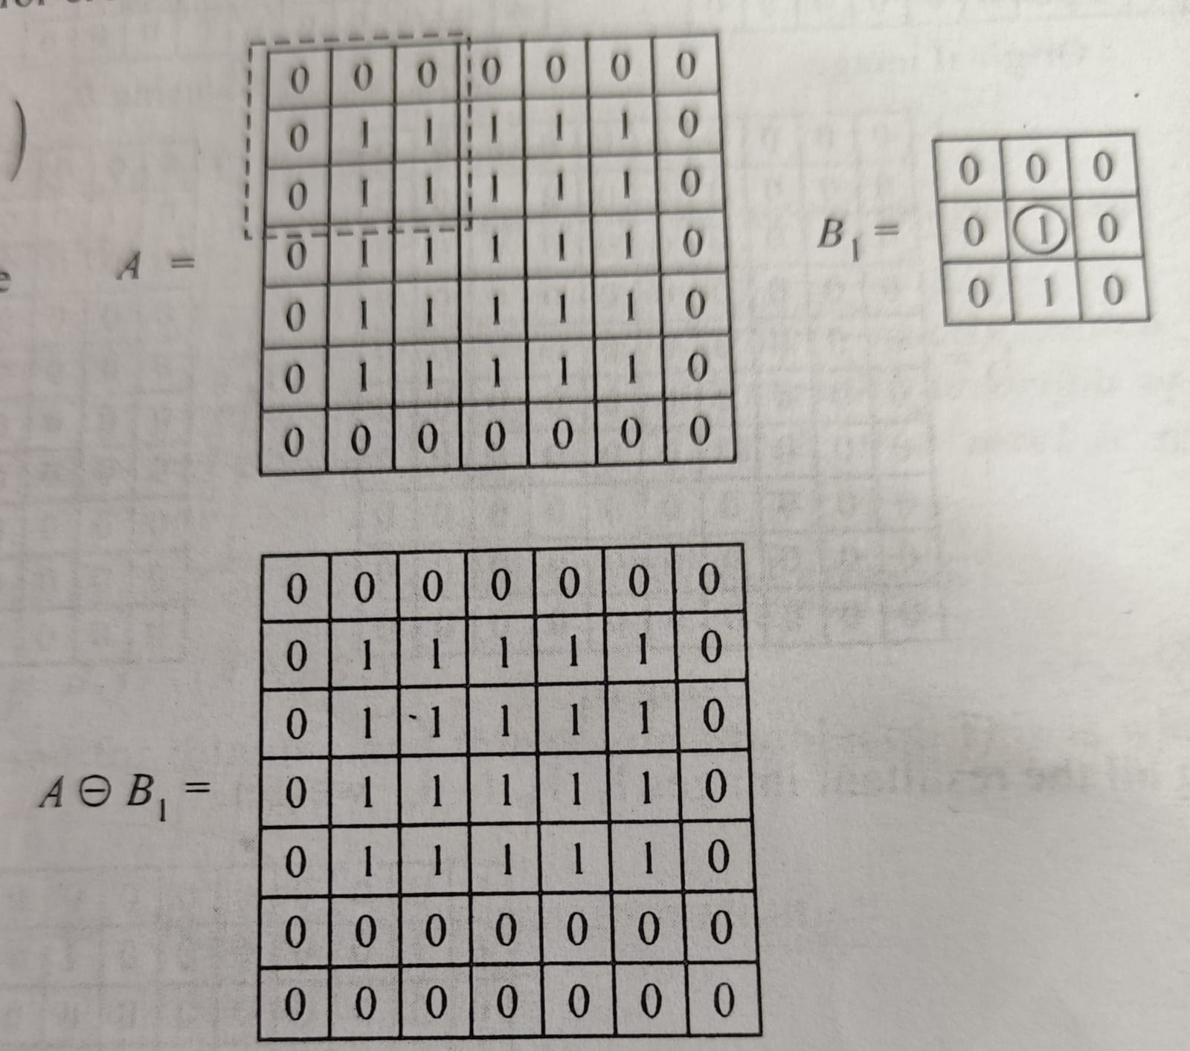
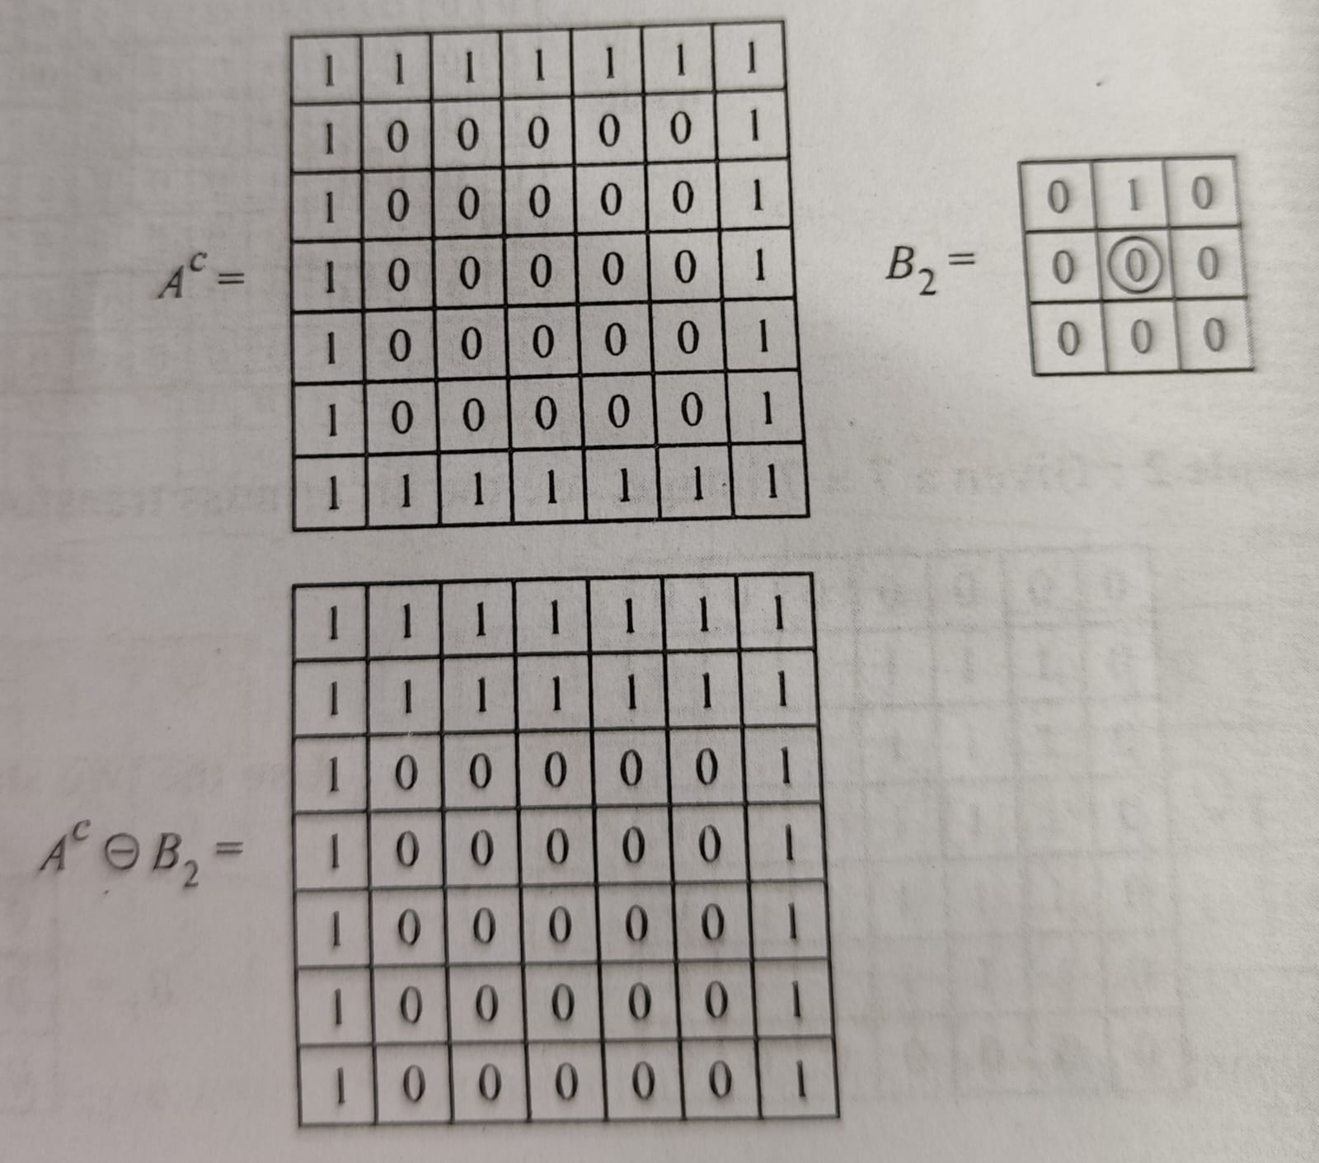

Slide 39
